Slide 1
Peter Pan Stem Challenge from home
3rd Grade Science Standard:
3.P.1 Understand motion and factors that affect motion

Slide 2
Home Challenge
HELP! Peter Pan is no longer able to fly. You must construct a zip line to get him to Neverland the fastest. Peter Pan must travel 50 inches on your zip line in order to get to Neverland. You will need to create a harness to put Peter Pan in, in order to get him down the zip line.
This Photo by Unknown Author is licensed under CC BY-SA

Slide 3
Longest Zipline in the World

Slide 4
Materials at Home
You may use any materials you have around the house to construct your zipline. Just remember that you will need a wire/string that is 5o inches long (strung between two points) for Peter Pan to fly on. You can use up to 3 pennies taped to your paper Peter Pan silhouette HERE to weigh him down a bit.
Possible materials may include: pipe cleaners, straws, rubber bands, paper clips, tape, index cards, lego, etc.

Slide 5
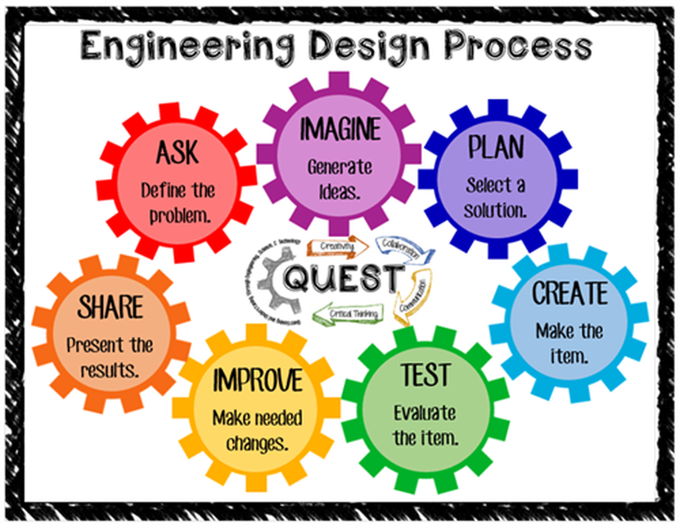
Engineering Design Process
Use the Engineering Design Process and the recording sheet linked HERE to create your design.

Slide 6
Reflection
Use your Flipgrid submission to answer these three reflection questions.
What was the easiest part of the challenge and why?
What was the most difficult?
What were some of the factors that affected the speed of Peter Pan going down the zipline?

Slide 7
ZIPLINE SUBMISSION VIDEO
Once you have completed your zipline, submit a video here of your finished project. Be sure to answer all three submission questions and we must see your zipline in action during your video!
https://flipgrid.com/b1bc0867
You will need to use the password Bainbobcat to access Mrs. Blackmon’s Flipgrid

